Slide 1
Introduction to structures and Classes

Slide 2
Structures
A Structure is a collection of related data items, possibly of different types.
A structure type in C++ is called struct.
A struct is heterogeneous in that it can be composed of data of different types.
In contrast, array is homogeneous since it can contain only data of the same type.

Slide 3
Structures
Structures hold data that belong together.
Examples:
  Student record: student id, name, major, gender, start year, …
  Bank account: account number, name, currency, balance, …
  Address book: name, address, telephone number, …
In database applications, structures are called records.

Slide 4
Structures
Individual components of a struct type are called members (or fields).
Members can be of different types (simple, array or struct).
A struct is named as a whole while individual members are named using field identifiers.
Complex data structures can be formed by defining arrays of structs.

Slide 5
struct basics
Definition of a structure:
struct <struct-type>{
<type> <identifier_list>;
<type> <identifier_list>;
...
} ;
Example:
struct Date {
int day;
int month;
int year;
} ;
Each identifier
defines a member
of the structure.
The “Date” structure
has 3 members,
day, month & year.

Slide 6
struct examples
Example:
struct StudentInfo{
int Id;
int age;
char Gender;
double CGA;
};
Example:
struct StudentGrade{
char Name[15];
char Course[9];
int Lab[5];
int Homework[3];
int Exam[2];
};
The “StudentInfo”
structure has 4 members
of different types.
The “StudentGrade”
structure has 5
members of
different array types.

Slide 7
struct examples
Example:
struct BankAccount{
char Name[15];
int AcountNo[10];
double balance;
Date Birthday;
};
Example:
struct StudentRecord{
char Name[15];
int Id;
char Dept[5];
char Gender;
};
The “BankAcount”
structure has simple,
array and structure
types as members.
The “StudentRecord”
structure has 4
members.

Slide 8
struct basics
Declaration of a variable of struct type:
<struct-type> <identifier_list>;
Example:
StudentRecord Student1, Student2;
Student1 and Student2 are variables of StudentRecord type.
Name
Id Gender
Dept
Name
Id Gender
Dept
Student1
Student2

Slide 9
Ex. 1: struct basics
The members of a struct type variable are accessed with the dot (.) operator:
<struct-variable>.<member_name>;
Example:
strcpy(Student1.Name, "Chan Tai Man");
Student1.Id = 12345;
strcpy(Student1.Dept, "COMP");
Student1.gender = 'M';
cout << "The student is ";
switch (Student1.gender){
case 'F': cout << "Ms. "; break;
case 'M': cout << "Mr. "; break;
}
cout << Student1.Name << endl;
Student1
Name
Id Gender
Dept
Chan Tai Man
12345 M
COMP

Slide 10
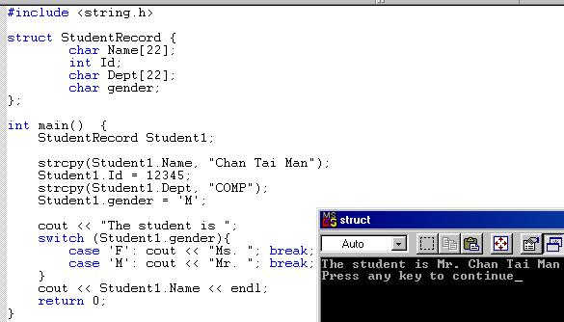

Slide 11
13.1 Procedural and Object-Oriented Programming
Procedural programming is a method of writing software. It is a programming practice centered on the procedures, or actions that take place in a program.
Object-Oriented programming is centered around the object. Objects are created form abstract data types that encapsulate data and functions together.

Slide 12
What’s Wrong with Procedural Programming?
Programs with excessive global data
Complex and convoluted programs
Programs that are difficult to modify and extend

Slide 13
What is Object-Oriented Programming?
OOP is centered around the object, which packages together both the data and the functions that operate on the data.

Slide 14
Figure 13-1
Member Variables
float width;
float length;
float area;
Member Functions
void setData(float w, float l)
{ … function code … }
void calcArea(void)
{ … function code … }
void getWidth(void)
{ … function code … }
void getLength(void)
{ … function code … }
void getArea(void)
{ … function code … }

Slide 15
Terminology
In OOP, an object’s member variables are often called its attributes and its member functions are sometimes referred to as its behaviors or methods.

Slide 16
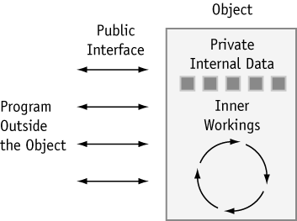
Figure 13-2

Slide 17
How are Objects Used?
Although the use of objects is only limited by the programmer’s imagination, they are commonly used to create data types that are either very specific or very general in purpose.

Slide 18
General Purpose Objects
  Creating data types that are improvements on C++’s built-in data types. For example, an array object could be created that works like a regular array, but additionally provides bounds-checking.
  Creating data types that are missing from C++. For instance, an object could be designed to process currencies or dates as if they were built-in data types.
  Creating objects that perform commonly needed tasks, such as input validation and screen output in a graphical user interface.

Slide 19
Application-Specific Objects
Data types created for a specific application. For example, in an inventory program.

Slide 20
13.2 Introduction to the Class
In C++, the class is the construct primarily used to create objects.
    class class-name
    {
    // declaration statements here
    };

Slide 21
Example:
    class Rectangle
    {
    private:
    float width, length, area;
    public:
    void setData(float, float);
    void calcArea(void);
    float getWidth(void);
    float getLength(void);
    float getArea(void);
    };

Slide 22
Access Specifiers
The key words private and public are access specifiers.
private means they can only be accessed by the member functions.
public means they can be called from statements outside the class.
  Note: the default access of a class is private, but it is still a good idea to use the private key word to explicitly declare private members. This clearly documents the access specification of the class.

Slide 23
13.3 Defining Member Functions
Class member functions are defined similarly to regular functions.
    void Rectangle::setData(float w, float l)
    {
    width = w;
    length = l;
    }

Slide 24
13.4 Defining an Instance of a Class
Class objects must be defined after the class is declared.
Defining a class object is called the instantiation of a class.
Rectangle box; // box is an instance of Rectangle

Slide 25
Accessing an Object’s Members
box.calcArea();

Slide 26
Pointers to Objects
Rectangle *boxPtr;
boxPtr = &box;
boxPtr->setData(15,12);

Slide 27
Program 13-1
// This program demonstrates a simple class.
#include <iostream.h>
// Rectangle class declaration.
class Rectangle
{
private:
float width;
float length;
float area;
public:
void setData(float, float);
void calcArea(void);
float getWidth(void);
float getLength(void);
float getArea(void);
};

Slide 28
Program continues
// setData copies the argument w to private member width and
// l to private member length.
void Rectangle::setData(float w, float l)
{
width = w;
length = l;
}
// calcArea multiplies the private members width and length.
// The result is stored in the private member area.
void Rectangle::calcArea(void)
{
area = width * length;
}

Slide 29
Program continues
// getWidth returns the value in the private member width.
float Rectangle::getWidth(void)
{
return width;
}
// getLength returns the value in the private member length.
float Rectangle::getLength(void)
{
return length;
}
// getArea returns the value in the private member area.
float Rectangle::getArea(void)
{
return area;
}

Slide 30
Program continues
void main(void)
{
Rectangle box;
float wide, long;
cout << "This program will calculate the area of a\n";
cout << "rectangle. What is the width? ";
cin >> wide;
cout << "What is the length? ";
cin >> long;
box.setData(wide, long);
box.calcArea();
cout << "Here is the rectangle's data:\n";
cout << "width: " << box.getWidth() << endl;
cout << "length: " << box.getLength() << endl;
cout << "area: " << box.getArea() << endl;
}

Slide 31
Program Output
This program will calculate the area of a
rectangle. What is the width? 10 [Enter]
What is the length? 5 [Enter]
Here is the rectangle's data:
width: 10
length: 5
area: 50

Slide 32
13.5 Why Have Private Members?
In object-oriented programming, an object should protect its important data by making it private and providing a public interface to access that data.

Slide 33
13.6 Focus on Software Engineering: Some Design Considerations
Usually class declarations are stored in their own header files. Member function definitions are stored in their own .CPP files.
The #ifndef directive allows a program to be conditionally compiled. This prevents a header file from accidentally being included more than once.

Slide 34
Program 13-2
Contents of RECTANG.H
#ifndef RECTANGLE_H
#define RECTANGLE_H
// Rectangle class declaration.
class Rectangle
{
private:
float width;
float length;
float area;
public:
void setData(float, float);
void calcArea(void);
float getWidth(void);
float getLength(void);
float getArea(void);
};
#endif

Slide 35
Program continues
Contents of RECTANG.CPP
#include "rectang.h"
// setData copies the argument w to private member width and
// l to private member length.
void Rectangle::setData(float w, float l)
{
width = w;
length = l;
}
// calcArea multiplies the private members width and length.
// The result is stored in the private member area.
void Rectangle::calcArea(void)
{
area = width * length;
}

Slide 36
Program continues
// getWidth returns the value in the private member width.
float Rectangle::getWidth(void)
{
return width;
}
// getLength returns the value in the private member length.
float Rectangle::getLength(void)
{
return length;
}
// getArea returns the value in the private member area.
float Rectangle::getArea(void)
{
return area;
}

Slide 37
Program continues
Contents of the main program, PR13-2.CPP
// This program demonstrates a simple class.
#include <iostream.h>
#include "rectang.h" // contains Rectangle class declaration
// Don't forget to link this program with rectang.cpp!
void main(void)
{
Rectangle box;
float wide, long;
cout << "This program will calculate the area of a\n";
cout << "rectangle. What is the width? ";
cin >> wide;
cout << "What is the length? ";
cin >> long;

Slide 38
Program continues
box.setData(wide, long);
box.calcArea();
cout << "Here rectangle's data:\n";
cout << "width: " << box.getWidth() << endl;
cout << "length: " << box.getLength() << endl;
cout << "area: " << box.getArea() << endl;
}

Slide 39
Performing I/O in a Class Object
    Notice that the Rectangle example has no cin or cout.
    This is so anyone who writes a program that uses the Rectangle class will not be “locked into” the way the class performs input or output.
    Unless a class is specifically designed to perform I/O, operations like user input and output are best left to the person designing the application.

Slide 40
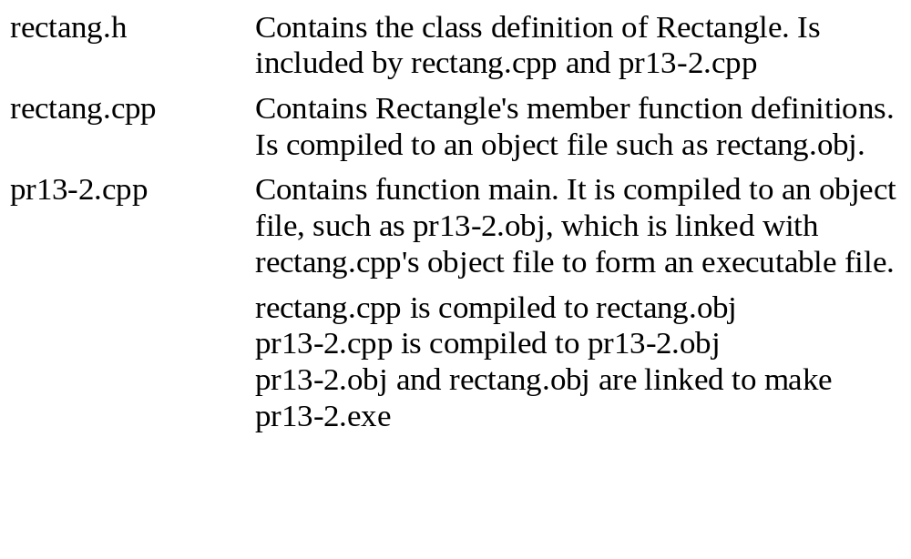
Table 13-1

Slide 41
13.7 Focus on Software Engineering: Using Private Member Functions
A private member function may only be called from a function that is a member of the same object.

Slide 42
Program 13-3
#include <iostream.h>
#include "rectang2.h" // contains Rectangle class declaration
// Don't forget to link this program with rectang2.cpp!
void main(void)
{
Rectangle box;
float wide, long;
cout << "This program will calculate the area of a\n";
cout << "rectangle. What is the width? ";
cin >> wide;
cout << "What is the length? ";
cin >> long;
box.setData(wide, long);
cout << "Here rectangle's data:\n";
cout << "width: " << box.getWidth() << endl;
cout << "length: " << box.getLength() << endl;
cout << "area: " << box.getArea() << endl;
}

Slide 43
Program Output
This program will calculate the area of a
rectangle. What is the width? 10 [Enter]
What is the length? 5 [Enter]
Here rectangle's data:
width: 10
length: 5
area: 50

Slide 44
13.8 Inline Member Functions
When the body of a member function is defined inside a class declaration, it is declared inline.

Slide 45
Program 13-4
Contents of RECTANG3.H
#ifndef RECTANGLE_H
#define RECTANGLE_H
// Rectangle class declaration.
class Rectangle
{
private:
float width;
float length;
float area;
void calcArea(void) { area = width * length; }

Slide 46
Program continues
public:
void setData(float, float); // Prototype
float getWidth(void) { return width; }
float getLength(void) { return length; }
float getArea(void) { return area; }
};
#endif
Contents of rectang3.cpp
#include "rectang3.h"
// setData copies the argument w to private member width and
// l to private member length.
void Rectangle::setData(float w, float l)
{
width = w;
length = l;
calcArea();
}

Slide 47
Program continues
Contents of the main program, pr13-4.cpp
#include <iostream.h>
#include "rectang3.h" // contains Rectangle class declaration
// Don't forget to link this program with rectang3.cpp!
void main(void)
{
Rectangle box;
float wide, long;
cout << "This program will calculate the area of a\n";
cout << "rectangle. What is the width? ";
cin >> wide;
cout << "What is the length? ";
cin >> long;

Slide 48
Program continues
box.setData(wide, long);
cout << "Here rectangle's data:\n";
cout << "width: " << box.getWidth() << endl;
cout << "length: " << box.getLength() << endl;
cout << "area: " << box.getArea() << endl;
}

Slide 49
Program Output
This program will calculate the area of a
rectangle. What is the width? 10 [Enter]
What is the length? 5 [Enter]
Here rectangle's data:
width: 10
length: 5
area: 50

Slide 50
13.9 Constructors
A constructor is a member function that is automatically called when a class object is created.
Constructors have the same name as the class.
Constructors must be declared publicly.
Constructors have no return type.

Slide 51
Program 13-5
// This program demonstrates a constructor.
#include <iostream.h>
class Demo
{
public:
Demo(void); // Constructor
};
Demo::Demo(void)
{
cout << "Welcome to the constructor!\n";
}

Slide 52
Program continues
void main(void)
{
Demo demoObj; // Declare a Demo object;
cout << "This program demonstrates an object\n";
cout << "with a constructor.\n";
}

Slide 53
Program Output
Welcome to the constructor.
This program demonstrates an object
with a constructor.

Slide 54
Program 13-6
// This program demonstrates a constructor.
#include <iostream.h>
class Demo
{
public:
Demo(void); // Constructor
};
Demo::Demo(void)
{
cout << "Welcome to the constructor!\n";
}

Slide 55
Program continues
void main(void)
{
cout << "This is displayed before the object\n";
cout << "is declared.\n\n";
Demo demoObj;
cout << "\nThis is displayed after the object\n";
cout << "is declared.\n";
}

Slide 56
Program Output
This is displayed before the object
is declared.
Welcome to the constructor.
This is displayed after the object
is declared.

Slide 57
Constructor Arguments
When a constructor does not have to accept arguments, it is called an object’s default constructor. Like regular functions, constructors may accept arguments, have default arguments, be declared inline, and be overloaded.

Slide 58
Program 13-7
// This program demonstrates a class with a constructor
#include <iostream.h>
#include <string.h>
class InvItem
{
private:
char *desc;
int units;
public:
InvItem(void) { desc = new char[51]; }
void setInfo(char *dscr, int un) { strcpy(desc, dscr);
units = un;}
char *getDesc(void) { return desc; }
int getUnits(void) { return units; }
};

Slide 59
Program continues
void main(void)
{
InvItem stock;
stock.setInfo("Wrench", 20);
cout << "Item Description: " << stock.getDesc() << endl;
cout << "Units on hand: " << stock.getUnits() << endl;
}

Slide 60
Program Output
Item Description: Wrench
Units on hand: 20

Slide 61
13.10 Destructors
A destructor is a member function that is automatically called when an object is destroyed.
  Destructors have the same name as the class, preceded by a tilde character (~)
  In the same way that a constructor is called then the object is created, the destructor is automatically called when the object is destroyed.
  In the same way that a constructor sets things up when an object is created, a destructor performs shutdown procedures when an object is destroyed.

Slide 62
Program 13-8
// This program demonstrates a destructor.
#include <iostream.h>
class Demo
{
public:
Demo(void); // Constructor
~Demo(void); // Destructor
};
Demo::Demo(void)
{
cout << "Welcome to the constructor!\n";
}

Slide 63
Program continues
Demo::~Demo(void)
{
cout << "The destructor is now running.\n";
}
void main(void)
{
Demo demoObj; // Declare a Demo object;
cout << "This program demonstrates an object\n";
cout << "with a constructor and destructor.\n";
}

Slide 64
Program Output
Welcome to the constructor!
This program demonstrates an object
with a constructor and destructor.
The destructor is now running.

Slide 65
Program 13-9
#include <iostream.h>
#include <string.h>
class InvItem
{
private:
char *desc;
int units;
public:
InvItem(void) { desc = new char[51]; }
~InvItem(void) { delete desc; }
void setInfo(char *dscr, int un) { strcpy(desc, dscr);
units = un;}
char *getDesc(void) { return desc; }
int getUnits(void) { return units; }
};

Slide 66
Program continues
void main(void)
{
InvItem stock;
stock.setInfo("Wrench", 20);
cout << "Item Description: " << stock.getDesc() << endl;
cout << "Units on hand: " << stock.getUnits() << endl;
}

Slide 67
Program Output
Item Description: Wrench
Units on hand: 20

Slide 68
13.11 Constructors that Accept Arguments
Information can be passed as arguments to an object’s constructor.

Slide 69
Program 13-10
Contents of sale.h
#ifndef SALE_H
#define SALE_H
// Sale class declaration
class Sale
{
private:
float taxRate;
float total;
public:
Sale(float rate) { taxRate = rate; }
void calcSale(float cost)
{ total = cost + (cost * taxRate) };
float getTotal(void) { return total; }
};
#endif

Slide 70
Program continues
Contents of main program, pr13-10.cpp
#include <iostream.h>
#include "sale.h"
void main(void)
{
Sale cashier(0.06); // 6% sales tax rate
float amnt;
cout.precision(2);
cout.setf(ios::fixed | ios::showpoint);
cout << "Enter the amount of the sale: ";
cin >> amnt;
cashier.calcSale(amnt);
cout << "The total of the sale is $";
cout << cashier.getTotal << endl;
}

Slide 71
Program Output
Enter the amount of the sale: 125.00
The total of the sale is $132.50

Slide 72
Program 13-11
Contents of sale2.h
#ifndef SALE2_H
#define SALE2_H
// Sale class declaration
class Sale
{
private:
float taxRate;
float total;
public:
Sale(float rate = 0.05) { taxRate = rate; }
void calcSale(float cost)
{ total = cost + (cost * taxRate) };
float getTotal (void) { return total; }
};
#endif

Slide 73
Program continues
Contents of main program, pr13-11.cpp
#include <iostream.h>
#include "sale2.h"
void main(void)
{
Sale cashier1; // Use default sales tax rate
Sale cashier2 (0.06); // Use 6% sales tax rate
float amnt;
cout.precision(2);
cout.set(ios::fixed | ios::showpoint);
cout << "Enter the amount of the sale: ";
cin >> amnt;
cashier1.calcSale(amnt);
cashier2.calcSale(amnt);

Slide 74
Program continues
cout << "With a 0.05 sales tax rate, the total\n";
cout << "of the sale is $";
cout << cashier1.getTotal() << endl;
cout << "With a 0.06 sales tax rate, the total\n";
cout << "of the sale is $";
cout << cashier2.getTotal() << endl;
}

Slide 75
Program Output
Enter the amount of the sale: 125.00
With a 0.05 sales tax rate, the total
of the sale is $131.25
With a 0.06 sales tax rate, the total
of the sale is $132.50

Slide 76
13.12 Focus on Software Engineering: Input Validation Objects
This section shows how classes may be designed to validate user input.

Slide 77
Program 13-12
// This program demonstrates the CharRange class.
#include <iostream.h>
#include "chrange.h" // Remember to compile & link chrange.cpp
void main(void)
{
// Create an object to check for characters
// in the range J - N.
CharRange input('J', 'N');
cout << "Enter any of the characters J, K, l, M, or N.\n";
cout << "Entering N will stop this program.\n";
while (input.getChar() != 'N');
}

Slide 78
Program Output with Example Input
Enter any of the characters J, K, l, M, or N
Entering N will stop this program.
j
k
q
n [Enter]

Slide 79
13.13 Overloaded Constructors
More than one constructor may be defined for a class.

Slide 80
Program 13-13
Contents of invitem2.h
#ifndef INVITEM2_H
#define INVITEM2_H
#include <string.h> // Needed for strcpy function call.
// InvItem class declaration
class InvItem
{
private:
char *desc;
int units;
public:
InvItem(int size = 51) { desc = new char[size]; }
InvItem(char *d) { desc = new char[strlen(d)+1];
strcpy(desc, d); }

Slide 81
Program continues
~InvItem(void) { delete[] desc; }
void setInfo(char *d, int u) { strcpy(desc, d); units = u;}
void setUnits (int u) { units = u; }
char *getDesc(void) { return desc; }
int getUnits(void) { return units; }
};
#endif
Contents of main program, pr13-13.cpp
// This program demonstrates a class with overloaded constructors
#include <iostream.h>
#include "invitem2.h"
void main(void)
{

Slide 82
Program continues
InvItem item1("Wrench");
InvItem item2;
item1.setUnits(15);
item2.setInfo("Pliers", 25);
cout << "The following items are in inventory:\n";
cout << "Description: " << item1.getDesc() << "\t\t";
cout << "Units on Hand: " << item1.getUnits() << endl;
cout << "Description: " << item2.getDesc() << "\t\t";
cout << "Units on Hand: " << item2.getUnits() << endl;
}

Slide 83
Program Output
The following items are in inventory:
Description: Wrench Units on Hand: 15
Description: Pliers Units on Hand 25

Slide 84
13.14 Only One Default Constructor and one Destructor
A class may only have one default constructor and one destructor.

Slide 85
13.15 Arrays of Objects
You may declare and work with arrays of class objects.
InvItem inventory[40];

Slide 86
Program 13-14
Contents of invitem3.h
#ifndef INVITEM3_H
#define INVITEM3_H
#include <string.h> // Needed for strcpy function call.
// InvItem class declaration
class InvItem
{
private:
char *desc;
int units;
public:
InvItem(int size = 51) { desc = new char[size]; }
InvItem(char *d) { desc = new[strlen(d)+1];
strcpy(desc, d); }

Slide 87
Program continues
InvItem(char *d, int u) { desc = new[strlen(d)+1];
strcpy(desc, d);
units = u; }
~InvItem(void) { delete [] desc; }
void setInfo(char * dscr, int u) { strcpy(desc, dscr); units = un;}
void setUnits (int u) { units = u; }
char *getDesc(void) { return desc; }
int getUnits(void) { return units; }
};
#endif
Contents of main program, pr13-14.cpp
// This program demonstrates an array of objects.
#include <iostream.h>
#include <iomanip.h>
#include "invitem3.h"

Slide 88
Program continues
void main(void)
{
InvItem Inventory[5] = { InvItem("Adjustable Wrench", 10),
InvItem("Screwdriver", 20), InvItem("Pliers", 35),
InvItem("Ratchet", 10), InvItem("Socket Wrench", 7)
};
cout << "Inventory Item\t\tUnits On Hand\n";
cout << "--------------------------------\n";
for (int Index = 0; Index < 5; Index++)
{
cout << setw(17) << Inventory[Index].GetDesc();
cout << setw(12) << Inventory[Index].GetUnits() << endl;
}
}

Slide 89
Program Output
Inventory Item Units On Hand
----------------------------------
Adjustable Wrench 10
Screwdriver 20
Pliers 35
Ratchet 10
Socket Wrench 7

